Slide 1

FUNCTIONAL RAM TESTING
Christian LANDRAULT
landraul@lirmm.fr

Slide 2
SUMMARY
Introduction
Memory modeling
Failure mechanisms and fault modeling
Test algorithms for RAM

Slide 3
Introduction
Memories (esp. RAM) are at the forefront of commercial electronic designs
DRAMs are the technology driver for the semiconductor industry
Memories are the most numerous IPs used in SOC designs (hundreds ! and >90% of an SoC in 2010)

Slide 4
Main types of semiconductor memory RAMs: Random Access Memories
Number of Memory
Cells per Chip
Dynamic Random Acess Memory (DRAM)
  Highest possible density
  Slow access time (typically 20ns)
  Information stored as charge on capacitor and should be refreshed
Static Random Acess Memory (SRAM)
  Fastest (typically 2ns)
  Information stored in cross coupled latches
10G
1G
512M
1G
128M
256M
100M
16M
64M
10M
1M
4M
1M
256k
100k
82
86
90
94
98
02
06

Slide 5
Memory testing
Memory testing has to prove that the circuits under test behave as designed, it consists of:
  Parametric tests which concern voltage/current levels and delays on the IO pins of the chip
  Functional testing including dynamic testing

Slide 6
Parametric (electrical) testing
AC Parametric testing
  Rise and fall time
  Setup and hold time
  Delay test
  Speed test
I_{DDQ} testing (CMOS memories only)
  Zero defect approach
  Use to detect some defects not handle by functional testing
DC Parametric testing
  Contact test
  Power consumption
  Leakage test
  Threshold test
  Output drive current test
  Output short current test

Slide 7
SUMMARY
Introduction
Memory modeling
Failure mechanisms and fault modeling
Test algorithms for RAM

Slide 8
Functional RAM Chip Model
Vdd
Vdd
Vdd
Address
Refresh
WL
WL
WL
Data in
Write
Address latch
Column decoder
Refresh logic
Vss
Vss
BL
BL
Vss
BL
BL
BL
BL
BL
BL
RAM write circuit
6-devices SRAM cell
poly
6-device SRAM cell
depletion
Two dimensional decoding scheme
(saves decoder and wiring area)
row decoder select row of cells via WL
column decoder
6-device SRAM cell
CMOS
Row
decoder
Memory
Cell Array
Write driver
WL
C
BL
single-device DRAM cell
Sense amplifiers
Data register
R/W and CE
Data out
Data in

Slide 9
Functional SRAM Chip Model
Address
Refresh
Address latch
Column decoder
Refresh logic
Row
decoder
Memory
Cell Array
Write driver
Sense amplifiers
Data register
R/W and CE
Data out
Data in

Slide 10
Functional SRAM Chip Model
Address
Address latch
Column decoder
Row
decoder
Memory
Cell Array
Write driver
Sense amplifiers
Data register
CE
R/W and
Data out
Data in

Slide 11
SUMMARY
Introduction
Memory modeling
Failure mechanisms and fault modeling
Test algorithms for RAM

Slide 12
Failure, errors and faults
A system failure occurs when the system behaviour is incorrect
Failures are cause by errors
An error is a difference between the faulty value and the golden one, this is the manifestation of a fault
A fault represents the physical difference between a good and incorrect system
Faults can be permanent or non-permanent

Slide 13
Failure Mechanisms
Corrosion
Electromigration (burning out of wires due to collision of electrons and Al grains)
Bonding deterioration (open due to interdiffusion of materials i.e. Au-Al)
Ionic contamination (modification of threshold voltages due to ion diffusion into transistor gate)
Alloying (Al atom migration into Si)
Radiation and cosmic rays (soft memory errors, …)
…….

Slide 14
Functional faults
Either a memory cell or a data register
Any wiring connection in the memory
Cell stuck
Driver stuck
Read/write line stuck
Chip-select line stuck
Data line stuck
Open in data line
Shorts between data lines
Crosstalk between data lines
Address line stuck
Open in address line
Shorts between address lines
Open decoder
Wrong access
Multiple access
Cell can be set to 0 and not to 1 (or vice versa)
Pattern sensitive interaction between cells

Slide 15
Reduced Functional Model
Address
Refresh
Address latch
Column decoder
Refresh logic
Read / Write logic
Row
decoder
Memory
Cell Array
Write driver
Memory Cell Array
Address decoder
Sense amplifiers
Data register
R/W and CE
Data out
Data in

Slide 16
Reduced Functional Model (cntd)
Address
Address decoder
Memory cell array
Read/write logic
Data

Slide 17
Fault Models: Address decoder Fault AF
4 Address decoder Faults which cannot stand alone (assuming same fault during read and write operations and no sequential behavior of the faulty decoder)
1. A certain address access no cell
2. A certain cell is never accessed
3. A certain address access multiple cells
4. A certain cell is accessed by multiple addresses
A_{x}
C_{x}
C_{x}
A_{x}
C_{y}
A_{x}
C_{x}
A_{y}

Slide 18
Fault Models: Address decoder Fault AF
4 Combinations of Address decoder Faults
Fault A: 1+2
Fault B: 1+3
Fault C: 2+4
Fault D: 3+4
A_{x}
C_{x}
A_{x}
C_{x}
A_{y}
C_{y}
A_{x}
C_{x}
A_{y}
C_{y}
A_{x}
C_{x}
A_{y}
C_{y}

Slide 19
Conditions for detecting address faults AF
The March test should contain the two following march elements
↑(rx, … , wx)
↓(rx, … , wx)

Slide 20
Functional Memory Faults
A functional fault model is a non-empty set of fault primitives
A fault primitive is a difference between the observed and the expected memory behaviour
A fault primitive is denoted by <S/F/R>
  S describes the sensitizing operation sequence
  F describes the state stored in the faulty cell
  R describes the output of the read operation
  For example <1/0/-> is a stuck-at 1 and <0w1/0/-> is a rising transition fault

Slide 21
Taxonomy of Functional Memory Faults
Fault Primitive
C: Number of Cells
O: Number of Operations
C=1
Single Cell Fault
C>1
Coupling Fault
0=<1
Static Fault
O>1
Dynamic Fault
C=2
2-Coupling Fault
C=3
3-Coupling Fault
O=2
2-op Fault
0=3
3-op Fault

Slide 22
Static and Dynamic faults
Static faults: sensitisation needs only one operation (Testable by common March Tests)
  Static Single-Cell Faults (S1CF)
  Static Two-Cell Faults (S2CF)
  …
Dynamic faults: sensitisation needs more than one operation (Not testable by common March Tests)
  Dynamic Single-Cell Faults (D1CF)
  Dynamic Two-Cell Faults (D2CF)
  …

Slide 23
S1CF: Stuck-at fault (SAF)
The logic value of (a line or) a cell is always 0 (SA0) or 1 (SA1)
To detect memory cell's SAFs:
  SA0: Write 1 Read 1 (w1 r1)
  SA1: Write 0 Read 0 (w0 r0)

Slide 24
S1CF: Transition Fault
A cell fails to undergo a 0 → 1 transition (TF_{rise}) or a 1 → 0 transition (TF_{fall}) when it is written
To detect transition fault:
  TF_{rise} : w0 w1 r1
  TF_{fall} : w1 w0 r0

Slide 25
S1CF: Read Disturb Faults (RDF)
A Cell is said to have a RDF if the read operation performed on the cell returns an incorrect value while changing the contents of the cell to the wrong value
To detect Read Disturb Fault from each cell a 1 and a 0 should be read
  r0
  r1

Slide 26
S1CF: Deceptive Read Disturb Faults (DRDF)
A Cell is said to have a DRDF if the read operation performed on the cell returns the expected value while changing the contents of the cell to the wrong value
To detect Deceptive Read Disturb Fault each cell should be read twice successively. The first read sensitize the fault and the second detects it
  r0r0
  r1r1

Slide 27
S1CF: Incorrect Read Faults (IRF)
A Cell is said to have a IRF if a read operation performed on the cell returns the incorrect value while keeping the correct stored value in the cell
To detect Incorrect Read Fault from each cell a 1 and a 0 should be read
  r0
  r1

Slide 28
S1CF: Write Disturb Faults (WDF)
A Cell is said to have a WDF if a non transition write operation causes a transition in the cell
To detect Write Disturb Fault each cell should be read after a non-transition write
  0w0r0
  1w1r1

Slide 29
Fault models: Coupling Fault (2 cells)
Implies two cells: the victim cell and the aggressor cell
Different kinds of coupling faults:
  Inversion coupling faults
  Idempotent coupling faults
  State coupling faults
  Dynamic coupling faults
  Bridging faults
  ……..

Slide 30
S2CF: Inversion Coupling Fault
Inversion Coupling Fault (CF_{in}): The content of the victim cell is inverted if the aggressor cell has a transition
According to the kind of transition (0 → 1 or 1 → 0) there is two possible CF_{in} types:
< ↑ ; □ > < ↓ ; □ >
To detect CF_{in} between cell x (victim) and y (aggressor)
  CF_{in} (y rise → x inverted): w0x w0y w1y r0x.
  CF_{in} (y fall → x inverted): w0x w1y w0y r0x.

Slide 31
S2CF: Idempotent Coupling Fault
Idempotent Coupling Fault (CF_{id}): The victim is forced to 0 or 1 if the aggressor has a 0 → 1 or 1 → 0 transition
According to the kind of transition (0 → 1 or 1 → 0) there is four possible CF_{id} types:
< ↑ ; 0 > < ↓ ; 0 > < ↑ ; 1 > < ↓ ; 1 >
To detect CF_{id} between cell x (victim) and cell y (aggressor)
  CF_{id} (y rise → x=0): w1x w0y w1y r1x
  CF_{id} (y fall → x=1): w0x w1y w0y r0x
  CF_{id} (y rise → x=1): w0x w0y w1y r0x
  CF_{id} (y fall → x=0): w1x w1y w0y r1x

Slide 32
S2CF: State Coupling Fault
State Coupling Fault (CF_{st}): The coupled cell (victim) is forced to 0 or 1 if the coupling cell (aggressor) is in a certain state
There is four possible CF_{st} types:
< 0 ; 0 > < 0 ; 1 > < 1 ; 0 > < 1 ; 1 >
To detect CF_{st} between cell x (victim) and y (aggressor)
  CF_{st} (y=0 → x=0): w1x w0y r1x
  CF_{st} (y=0 → x=1): w0x w0y r0x
  CF_{st} (y=1 → x=0): w1x w1y r1x
  CF_{st} (y=1 → x=1): w0x w1y r0x

Slide 33
S2CF: Dynamic Coupling Fault
Dynamic Coupling Fault (CF_{dyn}): The victim is forced to 0 or 1 if the aggressor cell has a read or write operation
More general case of the Idempotent Coupling Fault (CF_{id}) because it can be sensitized by any read or write operation
There are four CF_{dyn} faults
  <r0 ⎢w0;0> <r0 ⎢w0;1> <r1 ⎢w1;0> <r1 ⎢w1;1>

Slide 34
S2CF: Write (read) disturb coupling fault
Write disturb coupling (CF_{wd}): A cell is said to have a CFwd if a non transition write perform on the victim results in a transition when the aggressor is set into a logic state
There are four types of CF_{wd} faults
Read disturb coupling (CF_{rd}): Two cells are said to have a CFrd if a read performed on the victim destroys the data stored in the victim if a given state is present in the aggressor
There are four types of CF_{rd} faults

Slide 35
S2CF: Incorrect read coupling fault
Incorrect read coupling fault (CF_{ir}): Two cells are said to have an CFir if a read performed on the victim returns the incorrect logic value when the aggressor is sent into a given state
There are four types of CF_{ir} faults

Slide 36
S2CF: Deceptive read disturb coupling fault
Deceptive read disturb coupling fault (CF_{dr}): A cells is said to have an CFdr if a read performed on the victim returns the correct logic value and changes the content of the victim, when the aggressor is sent into a given state
There are four types of CF_{dr} faults

Slide 37
Fault models: Bridging Faults (BF)
A short between cells or lines (2 or more)
This is a bidirectional fault caused by logic level rather than a transition
Two sorts of bridging faults (BFs) exist:
  AND-type (ABF): the shorted cells/lines take the AND value of their fault-free values (four possible ABFs)
  OR-type (OBF): the shorted cells/lines take the OR value of their fault-free values (four possible OBFs)
Can be made equivalent to a number of linked CFs, i.e.
  "Cell x is the victim of cell y" and "Cell y is the victim of cell x"
  The faults are linked. It is possible that they will hide each other.
To detect a BF, it might be necessary to write a certain pattern on adjacent memory cells, see checkerboard algorithm using (“010101…”) pattern.

Slide 38
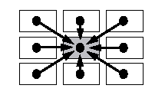
Pattern Sensitive (PSF)
The victim cell is forced to 0 or 1 if a certain number of neighbors show a particular pattern
The PSF is the most general k-coupling fault with k=n
With the Neighborhood Pattern Sensitive Fault (NPSF), the neighborhood is limited to all the cells in a single position surrounding the base cell
Equivalent to an N-coupling fault involving more than one aggressor (up to 8 adjacent locations)
Extremely hard to detect
  For each memory cell: the effect of all the possible combinations (2⁸) of the adjacent cells should be tested.

Slide 39
Neighborhood Pattern Sensitive (NPSF)
In practice two types of NPSF are used
The type-1 NPSF with 4 neighborhood cells (north, west, south, east)
The type-2 NPSF with 8 neighborhood cells
Base cell
Base cell
Type-1 neigh-
borhood cell
Type-2 neigh-
borhood cell
Type-1
Type-2

Slide 40
Neighborhood Pattern Sensitive (NPSF)
Active NPSF (ANPSF):
  change of the base cell due to a transition in the neighborhood cells
  Each base cell must be read in state 0 and in state 1, for all possible changes in the neighborhood pattern
Passive NPSF (PNPSF):
  the change of the base cell is impossible due to a certain neighborhood cells configuration
  Each base cell must be written and read in state 0 and in state 1, for all permutations in the neighborhood pattern
Static NPSF (SNPSF):
  The content of the base cell is forced to a certain state due to a certain neighborhood pattern
  Each base cell must be read in state 0 and in state 1, for all permutations in the neighborhood pattern

Slide 41
Dynamic Fault models: examples
Sense Amplifier (SA) Recovery Fault
  The SA saturates after a long sequence of 0s or 1s
Write Recovery Fault (addressing fault in the decoder)
  Write followed by a read/write to another location affects the previously accessed location
Detection needs At-Speed testing !!

Slide 42
Single-Cell Dynamic Fault Models: Dynamic RDF, IRF and DRDF
Definition similar to the static Read Disturb Fault, Incorrect Read Fault and Deceptive Read Disturb Faults with an initial write follows by one or more read operation
dRDF: A Cell is said to have a dRDF if a write followed by one or more read performed on the cell returns (on the last read) an incorrect value while changing the contents of the cell to the wrong value
dIRF: A Cell is said to have a dIRF if a write followed by one or more read performed on the cell returns (on the last read) incorrect value while keeping the correct stored value in the cell
dDRDF: A Cell is said to have a dDRRF if a write followed by one or more read performed on the cell returns (on the last read) the expected value while changing the contents of the cell to the wrong value

Slide 43
Fault models: Data Retention (DRF)
A cell fails to retain its logic value after some time
Due to a defective pull-up within a SRAM cell
A cell loses its value due to leakage current: the cell lose its charge due to this leakage current
Two different DRFs exist (loss of 1 and loss of 0) and may coexist
To detect DRF => a delay has to be inserted before reading back memory content (usually ~ 10-100 ms)
Can be easily add to any test algorithm
Test time increase dramatically !

Slide 44
Fault models: linked faults
Linked faults are two or more faults (coupling faults) that affect the same cell
Can be of the same type ( i.e. CF x->y and CF z->y )
or of different types ( i.e. CF x->y and TF_{rise} y )
They can hide each other (fault masking): Extremely difficult to detect
<↑;1>
<↑;1>
<↑;0>
<↑;0>
i
j
k
l
i
k
l
2 CF_{id} faults
2 CF_{id} linked faults

Slide 45
Relation between functional faults and fault models
Cell stuck
Driver stuck
Read/write line stuck
Chip-select line stuck
Data line stuck
Open in data line
Address line stuck
Open in address line
Shorts between address lines
Open decoder
Wrong access
Multiple access
SAF
AF
Shorts between data lines
Crosstalk between data lines
Cell can be set to 0 and not to 1 (or vice versa)
TF
Pattern sensitive interaction between cells
CF
NPSF

Slide 46
Relation between functional faults and fault models (examples)
1, 2, 3: SA0
4: AF for cells after the open
5, 6: State Coupling Faults
7: SAF (depending on the cell content and the technology)
Vdd
7
1
4
WL
5
6
3
2
BL
Vss
BL

Slide 47
dynamic Read Destructive Fault in the core cell [ETS04]
BL
BLB
WL
Defect 1
C O L U M N
D E C O D E R
Tp2
Tn2
Tn3
S
SB
Tn4
Tp1
Tn1
R O W
DECODER
Defect | Fault Model | Min Res(kΩ)
1 | dRDF | ~130
2 | RDF; DRDF | ~8
3 | RDF; DRDF | ~3
4 | TF | ~25
5 | IRF; TF | ~100
6 | TF | ~2000
MEMORY
ARRAY
I / O DATA
Defect 1 involves a dynamic Read Destructive Fault

Slide 48
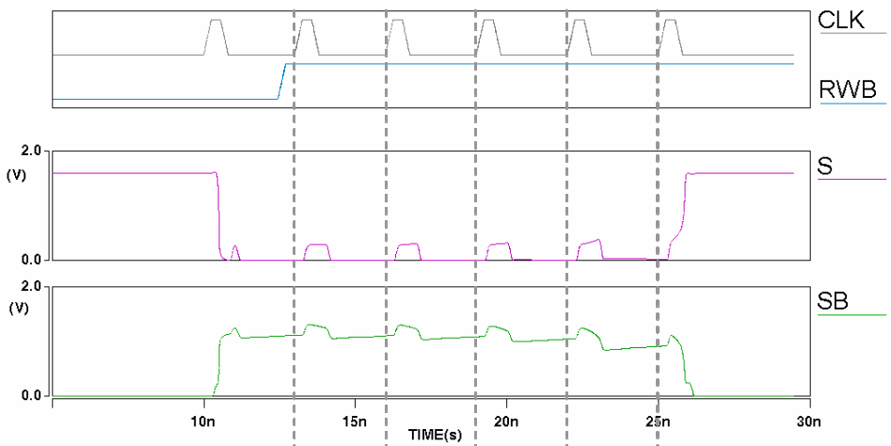
dynamic Read Destructive Fault in the core cell
w0
r0
r0
r0
r0
r0
Lower resistive size of Defect 1
⇒ more read operations are required to sensitize the fault

Slide 49
dynamic Read Destructive Fault in the core cell
10
w-r
w-r-r
8
w-r-r-r
w-r-r-r-r
6
w-r-r-r-r-r
R (MOhm)
No Fault
4
2
0
1,6
1,8
2
2,5
3
3,5
4
6
8
10
Cycle time (ns)
Detection of dRDF as function of resistance value, cycle time and number of read operation

Slide 50
Validity of fault models
Use of Inductive Fault Analysis at the layout level
  Generate defect sizes, location and layers (according to what may really happen in the fab.)
  Place the defect on a model of the layout
  Extract the schematic and electrical parameters for the defective cell
  Deduce and check possible fault models
Results depend on the used technology and fab. processes
Spot Size
<2μm
<9μm
SAF
51,3%
49,8%
SOF
21,0%
11,9%
TF
0%
7,0%
SCF
9,9%
13,2%
ICF
0%
3,3%
DRF
17,8%
14,8%

Slide 51
SUMMARY
Introduction
Memory modeling
Failure mechanisms and fault modeling
Test algorithms for RAM

Slide 52
Test Algorithms: notations used
  ↑ : indicates address ascending order
  ↓ : indicates address descending order
  w0 : write 0 at current location
  w1 : write 1 at current location
  r0 : read current location, expecting a 0
  r1 : read current location, expecting a 1
  (….): algorithm element
  {(…),(…),…,(…)}: full algorithm

Slide 53
Test algorithms
Full Behavioural test is definitively too consuming (3.n.2^{n})
Classical and early memory testing methods with test time proportional to
  n (zero-one, checkerboard, …)
  n² and n.log₂(n) (walking1/0, ping-pong, Galpat, Galcol, …)

Slide 54
Test algorithm: Zero-One
This minimal test consists of writing 0s and 1s in the memory
  Step1: write 0 in all cells
  Step2: read all cells (0 expected)
  Step3: write 1 in all cells
  Step4: read all cells (1 expected)
O(n) test
Fault coverage:
  Not all AFs detected
  SAFs detected if the adress decoder is fault free
  Not all TFs and CFs detected

Slide 55
Test algorithm: Checkerboard
Cell are divided in two groups
  Step1: write 1 in all green cells and 0
  in pink cells
  Step2: read all cells
  Step3: write 0 in all green cells and 1 in pink cells
  Step4: read all cells
O(n) test
Fault coverage:
  Not all AFs detected
  SAFs detected if the adress decoder is fault free
  Not all TFs and CFs detected
This test is able to detect bridging faults

Slide 56
Test algorithms: GALPAT and Walking 1/0
Memory is filled with 0s (or 1s) except for the base-cell which contains a 1 (0)
During the test the base cell walks through the memory
Difference between GALPAT and W 1/0 is in reading the base cell
0 0 0
0 1 0
0 0 0
0 → 0 → 0 → 0
0 1 0 → 0
0 → 0 → 0 → 0
GALPAT
Walking 1/0

Slide 57
Test algorithms: GALPAT and Walking 1/0
1 0 0 0 0
0 1 0 0 0
0 0 1 0 0
0 0 0 1 0
0 0 0 0 1
0 0 1 0 0
0 0 0 1 0
0 0 0 0 1
1 0 0 0 0
0 1 0 0 0
0 1 0 0 0
0 0 1 0 0
0 0 0 1 0
0 0 0 0 1
1 0 0 0 0
All AFs are detected and located
All SAFs are detected and located
All TFs are detected and located
All CFs are also detected and located
But both are O(n²) tests
other tests have been proposed as a shorter alternative (0(n^{3/2}):
  Sliding diagonal
  Butterfly (only neighboorhood cells of the base cell are read)
  GALCOL

Slide 58
Test algorithms test time
 | Number of operations
n | n | n.log₂n | n² (hr!!)
1Mb | 0.063 | 1.26 | 18.33
16Mb | 1.01 | 24.16 | 4691.3
256Mb | 16.11 | 451 | 1200959.9
2Gb | 128.9 | 3994.4 | 76861433.7
8774 Years !!

Slide 59
March tests
The test is "marching" through the memory
The test is composed of March elements represented between ()
March tests are the simplest tests (optimal ?) to detect most of the functional faults

Slide 60
March tests: example of MATS++
{↑(w0); ↑(r0,w1); ↓(r1,w0,r0)}
For i=0 to n-1
  Write 0 in cell C_{i}
For i=0 to n-1
  Read cell C_{i} and check its content (0 expected)
  Write 0 in cell C_{i}
For i=n-1 to 0
  Read cell C_{i} and check its content (1 expected)
  Write 0 in cell C_{i}
  Read cell C_{i} and check its content (0 expected)

Slide 61
March tests: example of MATS++
{↑(w0); ↑(r0,w1); ↓(r1,w0,r0)}
Takes 6n operations when used bit-wise
All SAFs are detected
All AFs unlinked with TFs are detected
All AFs linked with TFs are detected
All TFs are detected
0
1

Slide 62
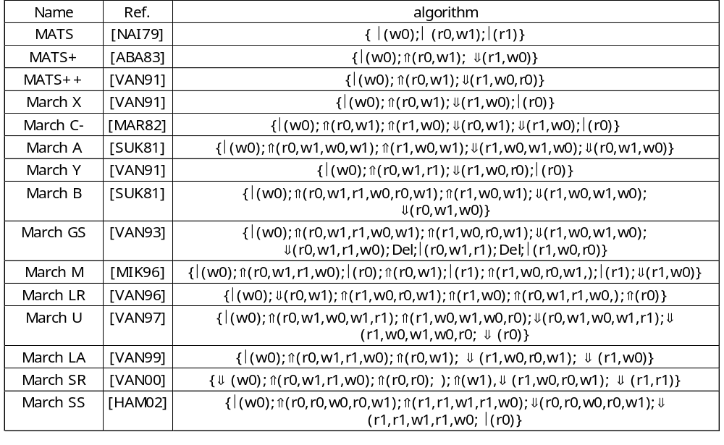
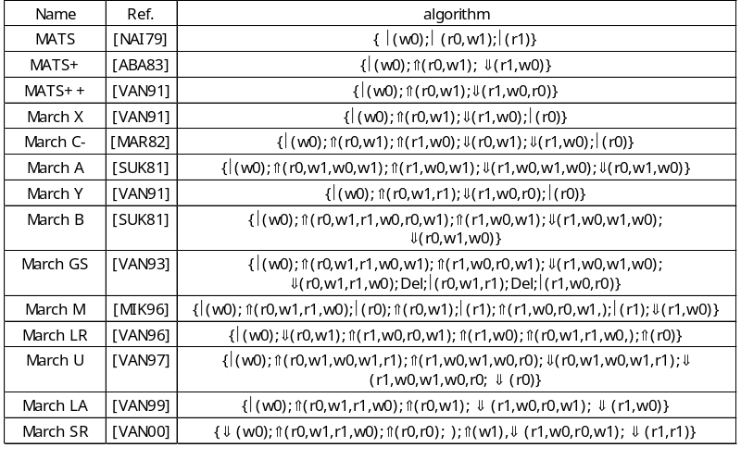
March test summary

Slide 63
March test Fault Coverage (example)
Algorithm | Fault Coverage |  |  |  |  |  |  |  | Operation count
 | SAF | AF | TF | CFin | CFid | CFdyn | SCF | Linked faults
MATS | All | Some |  |  |  |  |  |  | 4.n
MATS+ | All | All |  |  |  |  |  |  | 5.n
MATS++ | All | All | All |  |  |  |  |  | 6.n
March X | All | All | All | All |  |  |  |  | 6.n
March C- | All | All | All | All | All | All | All |  | 10.n
March A | All | All | All | All |  |  |  | All linked CFids, some CFins linked with CFids | 15.n
March Y | All | All | All | All |  |  |  | All TFs linked with CFins | 8.n
March B | All | All | All | All |  |  |  | All linked CFids, all TFs linked with CFids or CFins, some CFins linked with CFids | 17.n

Slide 64
March test Fault Coverage (example for single and two cell FFMs in %)
Algorithm | Single-Cell FFMs |  |  |  |  |  | Two-cell FFMs |  |  |  |  |  |  | Operation count
 | SF | TF | WDF | RDF | DRDF | IRF | CF st | CFds | CF tr | CFwd | CF rd | CFdrd | CF ir
MATS+ | 100 | 50 | - | 100 | - | 100 | 50 | 25 | 25 | - | 50 | - | 50 | 5.n
March B | 100 | 100 | - | 100 | - | 100 | 75 | 62 | 50 | - | 50 | - | 50 | 17.n
March U | 100 | 100 | - | 100 | - | 100 | 100 | 66 | 100 | - | 100 | - | 100 | 13.n
March C- | 100 | 100 | - | 100 | - | 100 | 100 | 66 | 100 | - | 100 | - | 100 | 10.n
March LR | 100 | 100 | - | 100 | - | 100 | 100 | 66 | 100 | - | 100 | - | 100 | 14.n
March SR | 100 | 100 | - | 100 | 100 | 100 | 100 | 66 | 100 | - | 100 | 75 | 100 | 14.n
March SS | 100 | 100 | 100 | 100 | 100 | 100 | 100 | 100 | 100 | 100 | 100 | 100 | 100 | 22.n

Slide 65
Testing of Neighborhood Pattern-Sensitive Faults
Active NPSF (ANPSF):
  Each base cell must be read in state 0 and in state 1, for all possible transitions in the neighborhood pattern
  (k-1).2^{k} possible patterns, (type-1: k=5, type-2: k=9)
Passive NPSF (PNPSF):
  Each base cell must be written and read in state 0 and in state 1, for all permutations in the neighborhood pattern
  2^{k} possible patterns
Static NPSF (SNPSF):
  Each base cell must be read in state 0 and in state 1, for all permutations in the neighborhood pattern
  2^{k} possible patterns

Slide 66
Testing of Neighborhood Pattern-Sensitive Faults
It is essential to minimize the number of writes during NPSF testing
SNPSF patterns are produced following an Hamiltonian sequence (hamiltonian distance of 1 between patterns, Gray code for example): k+2^{k}-1 writes
ANPSF and PNPSF patterns are produced following an Eulerian sequence : k+k.2^{k} writes

Slide 67
Testing of Neighborhood Pattern-Sensitive Faults
Number of writes further reduced by testing the neighborhoods simultaneously
Tilling method: number of writes divided by k
Two-group method (type-1 only): number of writes divided by 4
a
d
B
b
c
Group 1
Group 2
Notes:
When we are applying all the test patterns to all the base cell B which are n/5, its turn out that we are also applying the appropriate test patterns to the memory when cells a are base cells, cells b are base cells, cells c are base cells and cells d are base cells thus dividing the number of writes by 5. The same applies for type 2, in this case the number of writes is divided by 9.
For the two-group method, a cell is simultaneously a base cell in one group and a deleted neighbourhood cell in the other group and vice versa. In each group, we have n/2 base cells and n/2 deleted neighbourhood cells which are divided in four subgroups of size n/8: north, east, south and west. A new test pattern can be applied to all n/2 neighbourhoods of a group by writing into n/8 cells of a subgroup thus dividing the writes by 4.

Slide 68
Basic NPSF location algorithm
write base-cells with 0;
loop
apply a pattern; {it could change the base-cell from 0 to 1}
read base-cell;
endloop;
write base-cells with 1;
loop
apply a pattern; {it could change the base-cell from 1 to 0}
read base-cell;
endloop;

Slide 69
Basic NPSF detection algorithm
write base-cells with 0;
loop
apply a pattern; {it could change the base-cell from 0 to 1}
read base-cell;
endloop;
write base-cells with 1;
loop
apply a pattern; {it could change the base-cell from 1 to 0}
endloop;
read base-cell;
Only valid for ANPSF or SNPSF for which no transition is needed in the base cell
Tilling method cannot be used as base cells are changing

Slide 70
NPSF testing algorithm summary
Detection or Location
Algorithm | Location | Fault coverage |  |  |  |  | Operation count
 |  | SAF | TF | NPSF
 |  |  |  | A | P | S
TDANPSF1G | N | L |  | D |  |  | 163.5 n
TLAPNPSF1G | Y | L | L | L | L | L | 195.5 n
TLAPNPSF2T | Y | L | L | L | L |  | 5122 n
TLAPNPSF1T | Y | L | L | L | L |  | 194 n
TLSNPSF1G | Y | L |  |  |  | L | 43.5 n
TLSNPSF1T | Y | L |  |  |  | L | 39.2 n
TLSNPSF2T | Y | L |  |  |  | L | 569.8 n
TDSNPSF1G | N | L |  |  |  | D | 36.125 n
Active Passive Static
type-1
or
type-2
Tilling or 2-Group method

Slide 71
Test of Word-Oriented Memories
For SAFs and TFs which involve only one cell use data background and its complement instead of 0 and 1
MATS+ for a 4 bit memory
Data background = 0101
{↑(w0101); ↑(r0101,w1010); ↓(r1010,w0101)}

Slide 72
Test of Word-Oriented Memories
For CFs involving cells in different words use data background and its complement instead of 0 and 1
For CFs involving cells in the same word:
  If the write operation dominates the CF, no problem
  If the CF dominates the write operation, CF_{in} are detected but for CFid data background has to be replaced by B data background
For SCFs and BFs data background has also to be replaced by log₂B+1 data background

